Slide 1






SEO & SEM
A Complete Lecture Guide
Search Engine Optimization
Search Engine Marketing
Topics: Definitions • Keyword Research • On/Off/Technical SEO • Schema Markup • Backlink Types & Strategies • Black/Grey Hat • E-E-A-T • Google Ads • Meta Tags
Digital Marketing Series

Slide 2



What is SEO?
SEO (Search Engine Optimization) is the practice of optimizing a website to rank higher in organic (unpaid) search engine results pages (SERPs) to increase visibility and drive targeted traffic.
Organic Traffic
Long-Term Strategy
Algorithmic Process
Focuses on non-paid, natural search results that appear based on relevance and authority
Results take time but provide sustainable, cost-effective traffic growth over months
Search engines use 200+ ranking factors including content quality, links, and technical health

Slide 3

What is SEM?
SEM (Search Engine Marketing) is a digital marketing strategy that uses paid advertising to increase a website's visibility in SERPs, most commonly through Google Ads (PPC campaigns).
PPC Ads
Display Ads
Shopping Ads
Remarketing
Pay-Per-Click: Pay only when someone clicks your ad
Visual banner ads shown across Google's network
Product listings with image, price, and store name
Target users who've previously visited your website
💡 SEM is an umbrella term. In practice, SEM often refers specifically to paid advertising.

Slide 4
SEO vs SEM: Key Differences
Aspect
SEO
SEM (Paid)
Cost
Free (time investment)
Paid per click/impression
Speed
3–12 months to see results
Immediate visibility
Longevity
Long-lasting results
Stops when budget ends
Trust
Higher user trust
Lower (marked as 'Ad')
Targeting
Broad keyword targeting
Precise demographic targeting
Best For
Brand authority & growth
Product launches & quick wins

Slide 5




Why SEO & SEM Matter
93%
75%
68%
3.5B
of online experiences begin with a search engine
of users never scroll past the first page of results
of all website traffic comes from organic search
Google searches conducted every single day
Audience Reach
Cost Efficiency
Measurable Results
Competitive Edge
Brand Credibility
Connects your brand with users actively searching for your products/services
SEO provides the best ROI of any digital channel; SEM only costs when clicked
Track rankings, clicks, conversions, and revenue with precise analytics
Outrank competitors and capture market share in your niche
High organic rankings build consumer trust and brand authority

Slide 6

Types of SEO
On-Page SEO
Off-Page SEO
Technical SEO
Title tags, meta descriptions, content quality, keyword usage, headings (H1-H6), internal linking, image alt text, URL structure
Link building, social media marketing, guest blogging, brand mentions, influencer outreach, directory submissions
Site speed, mobile-friendliness, crawlability, site architecture, XML sitemaps, robots.txt, canonical tags, HTTPS security
Local SEO
Mobile SEO
E-commerce SEO
Google Business Profile, local citations, NAP consistency (Name, Address, Phone), local keywords, review management
Responsive design, fast mobile load times, touch-friendly UI, AMP (Accelerated Mobile Pages), mobile-friendly content
Structured data/schema markup, faceted navigation, product descriptions, category pages, rich snippets

Slide 7
Types of SEM (Paid Advertising)
Search Ads (PPC)
Display Ads
Shopping Ads
Text ads at top/bottom of SERPs. Triggered by keywords. Pay only when clicked.
Visual banner/image ads on Google Display Network (2M+ websites).
Product listings with image, price, store name. High purchase intent.
Ex: "Buy Running Shoes" → Google Ad appears
Ex: Image banner ad on a news website
Ex: Nike Air Max - $89.99 (product image)
Video Ads
App Campaigns
Remarketing
Skippable/non-skippable video ads on YouTube.
Promote mobile apps across Google Search, Play Store, YouTube.
Target users who previously visited your site with tailored messaging.
Ex: 15-second ad before YouTube video
Ex: App install ad for a fitness app
Ex: Ad for shoes user viewed but didn't buy

Slide 8

Keyword Research
Keyword research is the process of finding and analyzing search terms that users enter into search engines, to guide content strategy, SEO optimization, and paid ad campaigns.
What Keyword Research Helps You Discover:
Search Volume
Keyword Difficulty
CPC (Cost/Click)
User Intent
Content Gaps
Monthly searches per keyword
How hard it is to rank
What advertisers pay per click
What the searcher wants
Topics competitors rank for that you don't
🔧 Popular Tools:
Google Keyword Planner • Ahrefs • SEMrush • Moz • Ubersuggest • Google Trends • Answer The Public

Slide 9
Criteria for Keyword Selection
Search Volume
Keyword Difficulty (KD)
01
Monthly searches. Higher volume = more traffic potential. Aim for balance.
02
Score 0–100. Beginners target KD < 30. Authority sites target higher.
Target: 500–10,000+ for main keywords
New sites: KD 0–30 | Established: KD 30–70
Search Intent Match
Cost Per Click (CPC)
03
Does the keyword match what your page offers? Informational for blogs; transactional for products.
04
Higher CPC = strong commercial/buying intent.
Intent types: Informational, Navigational, Commercial, Transactional
High CPC ($2+) = High commercial value
Relevance & Context
Competition Analysis
05
Keyword must align with your business, product, or content topic.
06
Check who's ranking on page 1. Major brands DA 80+? May be too competitive.
Ask: Would this keyword bring ideal customers?
Check: Domain Authority of top 10 results

Slide 10
Keywords by Search Intent
KNOW
Informational Intent
Examples: "How does SEO work?" • "What is a backlink?"
User wants to learn. Not ready to buy yet.
CV: Low
Informational
GO
Navigational Intent
Examples: "Facebook login" • "Gmail inbox"
User wants to find a specific website or brand.
CV: Medium
Navigational
COMPARE
Commercial Intent
Examples: "Best SEO tools 2024" • "Ahrefs review"
User is researching before making a purchase.
CV: Medium-High
Commercial
DO
Transactional Intent
Examples: "Buy Nike shoes online" • "Free trial SEO tool"
User is ready to take an action — buy, sign up, download.
CV: Highest
Transactional

Slide 11
Keyword Match Types (Google Ads)
Broad Match
Phrase Match
Exact Match
keyword
"keyword"
[keyword]
Widest Reach
Moderate Reach
Precise Reach
Ads may show for searches related to your keyword, including synonyms and related searches.
Ads show when keyword phrase appears within the search.
Ads show only for exact keyword or very close variants.
Example:
Keyword: running shoes
Triggers: "jogging sneakers", "athletic footwear"
Example:
"running shoes"
Triggers: "buy running shoes", "cheap running shoes"
Example:
[running shoes]
Triggers: "running shoes", "run shoes"
✓ Maximum reach, discovers new audiences
✓ Balanced reach and relevance
✓ Most relevant traffic, best ROI
✗ Less relevant traffic, higher spend
✗ May miss some variations
✗ Limited reach, lower volume
Negative Keywords: Prevent ads showing for irrelevant searches. Adding 'free' as negative for a paid product prevents budget waste.

Slide 12
Long-Tail vs Short-Tail Keywords
Short-Tail Keywords
Long-Tail Keywords
(Head Terms — 1–2 words)
(3+ words — specific phrases)
Example:
"shoes" • "SEO" • "diet"
Example:
"best running shoes for flat feet"
Volume:
Very High (10K–1M+/mo)
Volume:
Low–Medium (50–2,000/mo)
Competition:
Extremely High
Competition:
Low to Medium
Conversion Rate:
Low (vague intent)
Conversion Rate:
High (specific intent)
Best For:
Brand awareness, large authority sites
Best For:
New sites, niche targeting, conversions
Cost (CPC):
Very Expensive
Cost (CPC):
Lower — more affordable
💡 Strategy: Use long-tail keywords to build traffic quickly, then pursue short-tail as your authority grows. 70% of all searches are long-tail.

Slide 13

Steps in Keyword Research
Define Your Goals & Niche
Brainstorm Seed Keywords
1
2
Identify your target audience, business objectives, and topic area.
List core topics and broad terms. Think like your customer.
Use Keyword Research Tools
Analyze Volume & Difficulty
3
4
Enter seed keywords into Keyword Planner, Ahrefs, or SEMrush.
Filter by monthly search volume (>100) and keyword difficulty score.
Evaluate Search Intent
Analyze Competitor Keywords
5
6
Classify each keyword by intent. Match intent to your page type.
Find keywords competitors rank for. Identify content gaps.
Prioritize & Create List
Map Keywords to Pages
7
8
Score by opportunity. Build master spreadsheet with primary, secondary, LSI keywords.
Assign 1 primary keyword per page. Avoid keyword cannibalization.

Slide 14
SEO: The Three Pillars
ON-PAGE SEO
OFF-PAGE SEO
TECHNICAL SEO
What's ON your website
What happens OUTSIDE
BACKEND health of your site
› Title Tags & Meta Descriptions
› Backlink Building (Quality Links)
› Site Speed (Core Web Vitals)
› Keyword Optimization in Content
› Guest Blogging & Outreach
› Mobile Responsiveness
› Heading Structure (H1, H2, H3...)
› Social Media Signals
› SSL Certificate (HTTPS)
› URL Structure & Slug Optimization
› Brand Mentions & Citations
› XML Sitemap Submission
› Internal Linking Strategy
› Influencer Marketing
› Robots.txt Configuration
› Image Alt Text & File Names
› Press Releases & PR
› Canonical Tags
› Content Quality & Depth
› Forum Participation
› Crawlability & Indexability
› User Experience (UX) Signals
› Directory Listings
› Structured Data / Schema
› Schema Markup / Structured Data
› Digital PR Campaigns
› Fixing 404 Errors & Redirects

Slide 15
On-Page SEO — In Depth
Title Tag
Meta Description
Most important on-page factor. Include primary keyword near start. Keep under 60 characters.
160-character summary in SERPs. Affects CTR. Include keyword and call-to-action.
<title>Buy Running Shoes Online | BestShoes.com</title>
Find the best running shoes for all surfaces. Free shipping over $50. Shop now!
Header Tags (H1–H6)
Keyword Placement
H1 = main heading (1 per page, primary keyword). H2–H3 = subheadings for structure.
Place primary keyword in H1, first 100 words, title, URL, meta. Avoid keyword stuffing.
<h1>Best Running Shoes for 2024</h1>
<h2>Trail Running Shoes</h2>
Keyword density: 1–2%. Use LSI keywords throughout.
URL Structure
Content Quality
Short, descriptive URLs with keywords. Use hyphens not underscores.
E-E-A-T: Experience, Expertise, Authoritativeness, Trustworthiness. 1500+ words ranks better.
Good: /best-running-shoes-men
Bad: /product?id=12345&cat=shoes
Cover topics comprehensively. Add images, videos, FAQs, tables.

Slide 16
Off-Page SEO — In Depth
The most important Off-Page SEO factor is BACKLINKS — links from other websites pointing to yours. Google sees backlinks as votes of confidence.
Link Building
Guest Blogging
Social Signals
Acquire backlinks from high DA websites. Quality over quantity.
Write valuable articles for other industry blogs. Include a link back to your site.
Shares, likes, and engagement on social media indirectly boost SEO.
📌 Guest posts, broken link building, skyscraper technique, resource pages
📌 Find sites: site:example.com "write for us"
📌 Share on LinkedIn, Twitter/X, Pinterest, Facebook consistently
Brand Mentions
Local Citations
Digital PR
Unlinked brand mentions help SEO. Convert unlinked mentions into backlinks.
NAP consistency across directories boosts local SEO.
Create newsworthy content to earn links from news sites and high-authority publications.
📌 Use Google Alerts or Ahrefs to find brand mentions
📌 Submit to: Google Business Profile, Yelp, Yellow Pages, Bing Places
📌 Data studies, surveys, infographics, expert quotes

Slide 17
Technical SEO — In Depth
⚡ Core Web Vitals
📱 Mobile-First Indexing
🔒 HTTPS Security
🏗️ Site Architecture
LCP (< 2.5s), FID/INP (< 200ms), CLS (< 0.1). Direct ranking factor since 2021.
Google uses mobile version for indexing. Responsive design is mandatory.
SSL certificates encrypt data and are a confirmed ranking signal.
Flat hierarchy: every page reachable in 3 clicks. Use breadcrumbs.
🗺️ XML Sitemap
🤖 Robots.txt
🔗 Canonical Tags
🕷️ Crawl Budget
Submit sitemap.xml to Google Search Console. Lists all important pages.
Controls which pages search engines can crawl. Block admin/thin pages.
Prevent duplicate content issues. Tell Google the 'official' URL.
Ensure Googlebot crawls important pages. Fix crawl errors in Search Console.

Slide 18


On-Page SEO — Types & What They Cover
Everything you control directly within your website pages
Content Optimization
HTML Tag Optimization
URL & Site Structure
▸ Target keyword in title, H1, first paragraph
▸ <title> tag: 50–60 chars, keyword first
▸ Short, descriptive slugs with hyphens
▸ Keyword density 1–2% (natural usage)
▸ <meta description>: 150–160 chars + CTA
▸ Keyword included in URL path
▸ LSI / semantic keywords throughout
▸ H1–H6 hierarchy with keyword variations
▸ Logical breadcrumb navigation
▸ Cover topic comprehensively (pillar pages)
▸ Image <alt> text describing image content
▸ Internal linking to related pages
▸ Use FAQs, tables, images, infographics
▸ Schema markup for rich snippets
▸ Canonical tags for duplicate content
UX & Engagement Signals
Image & Media SEO
Internal Linking
▸ Improve page load speed (< 2.5 sec)
▸ Descriptive file names (keyword-slug.jpg)
▸ Link related pages with keyword anchor text
▸ Mobile-responsive layout
▸ Alt text for every image
▸ Distribute PageRank across site
▸ Clear CTA buttons and navigation
▸ Compress images (WebP format)
▸ Use hub-and-spoke (pillar) model
▸ Reduce bounce rate with engaging content
▸ Lazy loading for images below fold
▸ Fix broken internal links regularly
▸ Increase dwell time with multimedia
▸ Video transcripts for accessibility
▸ Limit links per page to maintain value

Slide 19
On-Page SEO — Step-by-Step How To Do It
Follow this checklist for every page you want to rank
Keyword Research First
Optimize Your Title Tag
1
2
Identify ONE primary keyword + 3–5 secondary/LSI keywords for the page. Use Ahrefs, SEMrush, or Google Keyword Planner. Check search intent.
Write a compelling title: [Primary Keyword] + [Benefit/Modifier] | [Brand]. Keep under 60 characters.
🔧 Tool: Ahrefs → Keywords Explorer → filter by KD < 40 and volume > 500
✏️ Example: "Best SEO Tools 2024 – Ranked & Reviewed | SearchPro"
Write Meta Description
Structure Content (H1–H6)
3
4
150–160 character summary. Include primary keyword. Add compelling call-to-action.
One H1 per page with primary keyword. H2 for main sections, H3 for subsections. Write 1,500+ words for informational content.
✏️ Example: "Discover the 10 best SEO tools tested by experts. Start free today!"
📋 Structure: H1 (topic) → H2 (subtopic 1) → H3 (detail) → H2 (subtopic 2)...
Optimize Images & Media
Internal Linking Strategy
5
6
Rename files: 'seo-tools-comparison.jpg' not 'IMG_001.jpg'. Add alt text. Compress to < 200KB. Use WebP format.
Add 3–5 internal links to related pages using descriptive anchor text. Link from high-authority pages to new pages.
🖼️ Alt: alt="SEMrush vs Ahrefs comparison table 2024"
🔗 Example: anchor "keyword research guide" → links to your guide
Improve Page Speed & UX
Add Schema Markup
7
8
Target Core Web Vitals: LCP < 2.5s, CLS < 0.1, INP < 200ms. Use Google PageSpeed Insights.
Add structured data (JSON-LD) for Article, Product, FAQ, How-To, Review. Helps display rich snippets.
⚡ Test: pagespeed.web.dev — aim for 90+ score on mobile
💻 Use Schema.org or RankMath / Yoast plugins to auto-generate schema

Slide 20



Off-Page SEO — Types & Strategies
Building authority, trust and signals from outside your website
Off-page SEO = everything done OUTSIDE your website to improve rankings. The core idea: earn signals that prove your site is trusted and authoritative.
Link Building
Digital PR & Brand Mentions
Content Marketing
Earn quality backlinks from authoritative sites
Get featured in media, earn brand authority
Create content others naturally link to
▸ Guest posting on niche blogs
▸ Publish original data/research studies
▸ Publish ultimate guides (5,000+ words)
▸ Broken link building (replace dead links)
▸ Create shareable infographics
▸ Original research and statistics pages
▸ Skyscraper technique (better content → steal links)
▸ Issue press releases for newsworthy events
▸ Free tools, calculators, templates
▸ Resource page link building
▸ Respond to journalist queries (HARO, Qwoted)
▸ Comparison content (X vs Y)
▸ HARO (Help A Reporter Out) for PR links
▸ Sponsor industry events or podcasts
▸ Trending topic newsjacking
Social Media & Community
Local SEO Signals
Forum & Review Platforms
Amplify content and build brand signals
For businesses targeting local customers
Build trust signals and branded searches
▸ Share content across LinkedIn, X, Pinterest
▸ Google Business Profile optimization
▸ Participate in Reddit, Quora meaningfully
▸ Build community in Facebook/Reddit groups
▸ Consistent NAP across 50+ directories
▸ Respond to all Google/Yelp reviews
▸ Engage in Quora with expert answers
▸ Local newspaper/blog features
▸ Build presence on G2, Trustpilot, Capterra
▸ YouTube channel with backlinks in descriptions
▸ Local sponsorships (charity, sports teams)
▸ Answer questions on Stack Exchange
▸ Podcast appearances
▸ Customer review generation strategy
▸ LinkedIn articles and newsletters

Slide 21
Off-Page SEO — Step-by-Step Link Building Guide
The most impactful off-page SEO activity — building a strong backlink profile
LINK BUILDING PROCESS (Step-by-Step)
BACKLINK QUALITY FACTORS
1
Audit Your Existing Backlinks
Domain Authority (DA)
Use Ahrefs Site Explorer or SEMrush Backlink Audit. Check: total backlinks, referring domains, DA scores, toxic links. Disavow toxic links via Google Search Console.
Higher = Better (Aim for DA 40+)
2
Analyze Competitor Backlinks
Relevance
In Ahrefs: enter competitor URL → Backlinks report. Find sites linking to them but NOT you. These are your best outreach targets.
Same niche = 10x more valuable
3
Create Link-Worthy Content
Link Placement
Produce "linkable assets": original research, free tools, ultimate guides, data studies, infographics. Content must be 10x better than what ranks.
In-content > sidebar > footer
4
Find Guest Post Opportunities
Anchor Text
Search Google: "your niche" + "write for us" / "guest post" / "submit article". Filter for sites DA > 30 with real traffic.
Mix: brand, naked URL, partial match
5
Personalized Outreach
DoFollow vs NoFollow
Send personalized emails (NOT templates). Reference a specific post. Explain WHY your content adds value. Keep it short (under 150 words). Follow up once.
DoFollow passes link juice
6
Broken Link Building
Unique Referring Domains
Use Check My Links (Chrome extension) or Ahrefs to find broken links on relevant pages. Create replacement content. Email the site owner.
100 domains > 1000 links from 5 sites
7
Monitor & Maintain
Traffic on Linking Page
Track new/lost backlinks weekly in Ahrefs alerts. Reclaim lost links. Set Google Alerts for brand mentions. Convert unlinked mentions to backlinks.
Links from pages with real traffic

Slide 22

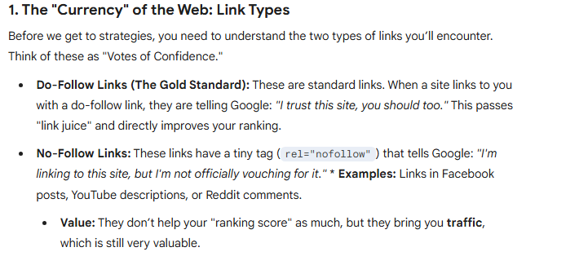

Slide 23
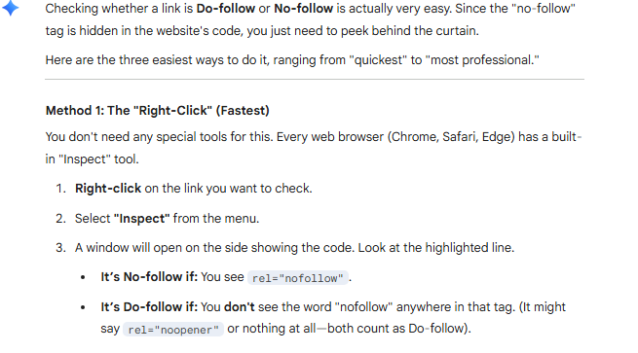
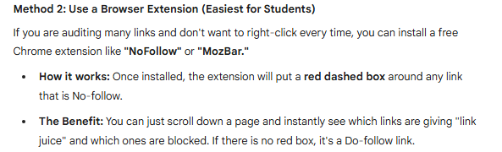

Slide 24
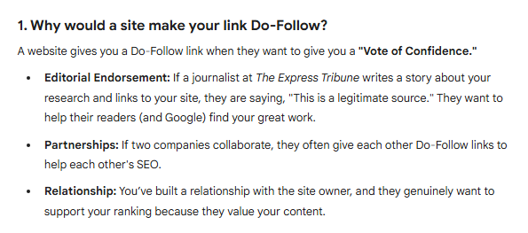
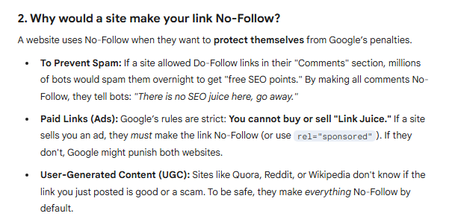

Slide 25
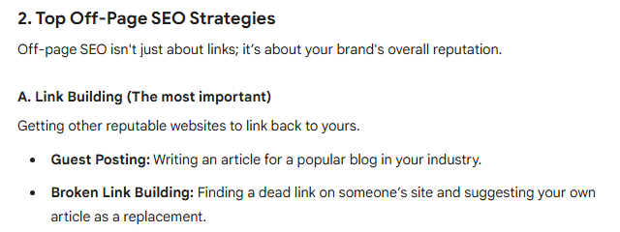
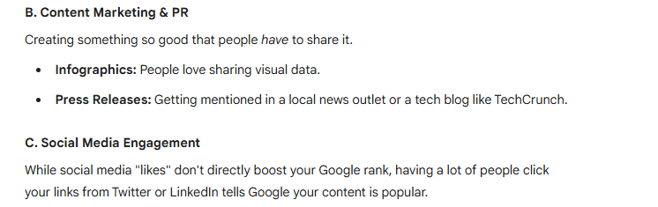

Slide 26
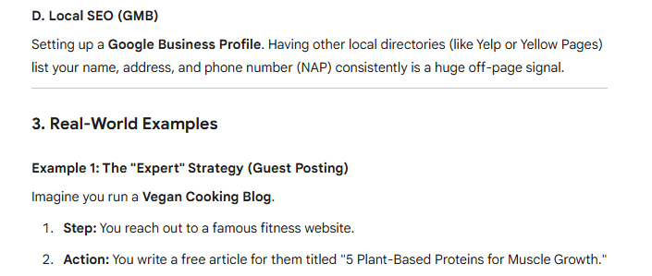
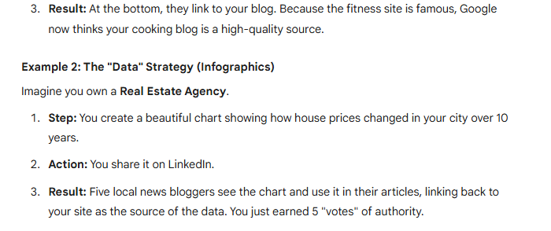

Slide 27
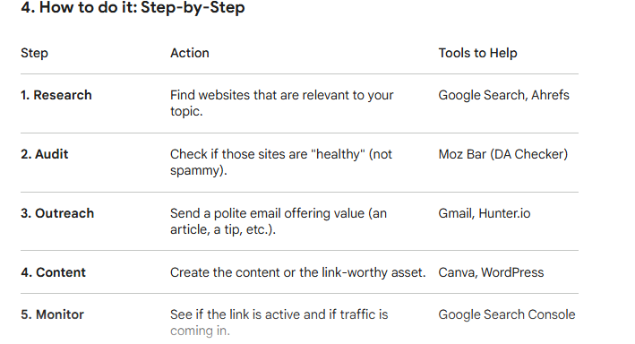

Slide 28
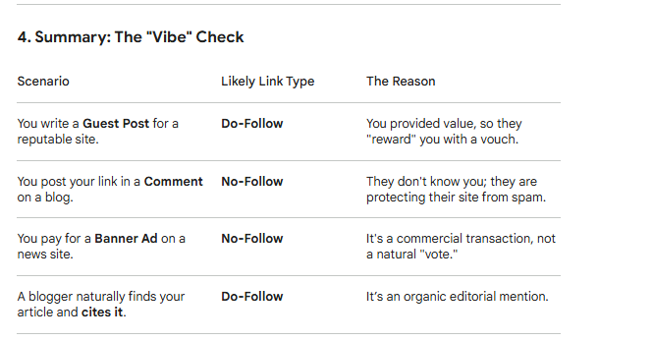

Slide 29



Technical SEO — Areas & What They Include
The foundation that allows search engines to properly access, crawl, and index your site
Crawlability
Indexability
Site Speed
Mobile Optimization
› robots.txt: Allow/Disallow crawl paths
› meta robots: index vs noindex
› Core Web Vitals: LCP, CLS, INP
› Responsive design (adapts to screen size)
› XML Sitemap submitted to Search Console
› X-Robots-Tag for non-HTML files
› Image compression (WebP / AVIF)
› Mobile-first indexing compliance
› Internal linking for deep page discovery
› Canonical tags prevent duplicate indexing
› Browser caching & CDN setup
› Tap target sizes (buttons ≥ 48px)
› Crawl budget optimization (large sites)
› Remove thin/low-quality pages or noindex
› Minify HTML, CSS, JavaScript files
› Font size ≥ 16px on mobile
› Fix crawl errors in Search Console
› Pagination handling (rel=next/prev)
› Eliminate render-blocking resources
› No intrusive interstitials (popups)
› No orphan pages (every page linked)
› Hreflang for multilingual sites
› Server response time (< 200ms TTFB)
› Test with Google Mobile-Friendly Test
Site Architecture
Structured Data
Security & Trust
International SEO
› Flat structure: max 3 clicks from homepage
› JSON-LD schema for Article, Product, FAQ
› HTTPS mandatory (Google ranking signal)
› Hreflang tags for language/region targeting
› Logical URL hierarchy (/category/sub/)
› Local Business schema for local SEO
› HSTS headers for strict security
› Country-specific domains or subdirectories
› Breadcrumb navigation with schema
› Breadcrumb schema for navigation
› No malware or hacked content
› Localized content (not just translated)
› Consistent URL format (trailing slash or not)
› Review/Rating schema for stars in SERPs
› Clear privacy policy page
› Google Search Console: target country
› HTTPS across all pages (SSL certificate)
› HowTo schema for step-by-step content
› Secure forms (no mixed content warnings)
› Local hosting or CDN near target users
› Proper 301 redirects (avoid chains/loops)
› Validate: Rich Results Test by Google
› Regular security audits (Sucuri, Wordfence)
› Currency and date format localization

Slide 30

Technical SEO — Step-by-Step Audit & Fix Guide
Run this audit process to find and fix technical issues hurting your rankings
Crawl Your Site with Screaming Frog
Check Google Search Console
1
Download Screaming Frog SEO Spider (free for < 500 URLs). Run a full crawl. Export results.
2
Go to Coverage report → find Excluded, Error, and Valid pages. Check Core Web Vitals. Review Manual Actions. Submit sitemap.
✓ Find: broken links (4xx), redirect chains (3xx), missing titles, duplicate meta, missing H1, thin pages (<300 words)
✓ Fix: Crawl errors, URL not indexed, soft 404s, mobile usability issues, security issues
Audit Site Speed with PageSpeed Insights
Check Mobile Friendliness
3
Test every major page template at pagespeed.web.dev. Focus on mobile score. Prioritize 'Opportunities'.
4
Use Google's Mobile-Friendly Test. Test on real devices. Check font sizes, button sizes, viewport settings.
✓ Fix: Unused JS/CSS, image sizing, server response, render-blocking, LCP element optimization
✓ Fix: Viewport meta tag, touch targets too small, content wider than screen, blocked resources
Audit URL Structure & Canonicals
Validate Structured Data
5
Ensure consistent URL format. Check for duplicate content (www vs non-www, http vs https). Add canonical tags.
6
Use Google Rich Results Test. Check schema markup on all key page types. Fix validation errors.
✓ Fix: Set up 301 redirects, implement canonical tags, consolidate URL variants
✓ Fix: Missing required fields, wrong schema type, errors in Search Console Enhancement reports
Review Internal Links & Sitemap
Monitor & Re-audit Monthly
7
In Screaming Frog: check Inlinks report. Find orphan/near-orphan pages. Ensure sitemap includes canonical, indexable URLs.
8
Set up Google Search Console email alerts. Use Ahrefs Site Audit on weekly crawl schedule.
✓ Fix: Add internal links to orphan pages, remove noindex pages from sitemap
✓ Ongoing: Fix broken links, monitor crawl budget, check for algorithm impact after Google updates

Slide 31
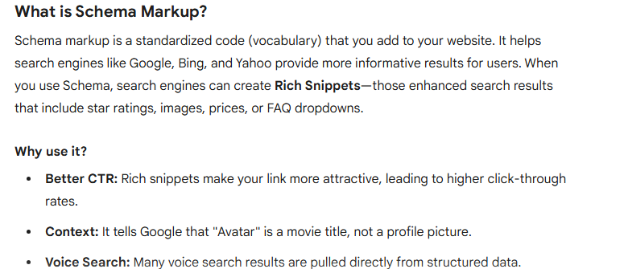

Slide 32
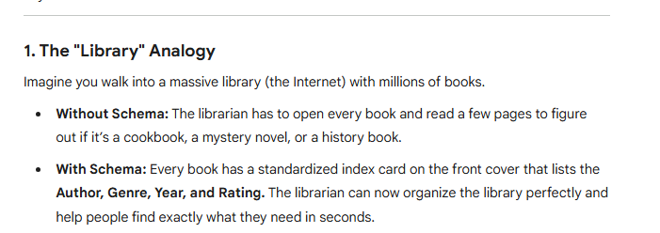

Slide 33
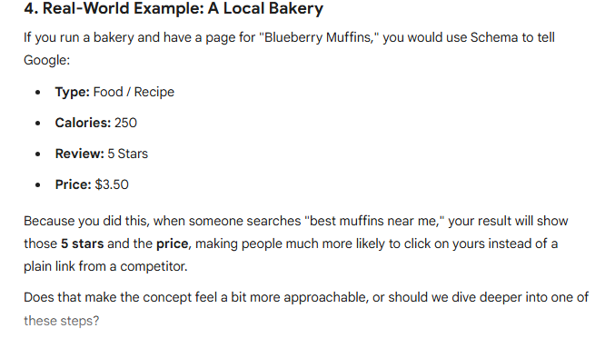

Slide 34
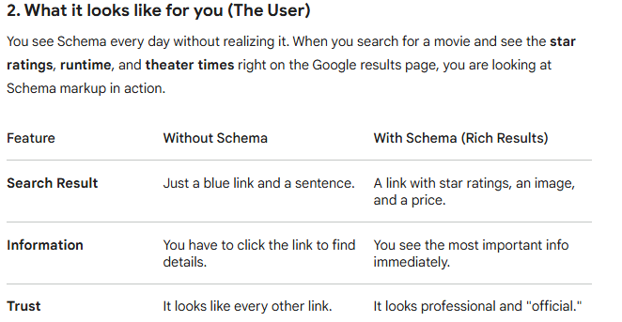

Slide 35
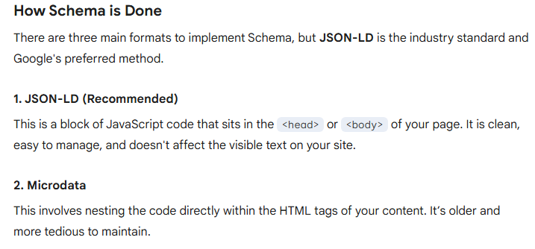

Slide 36
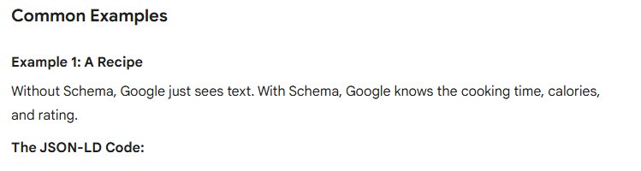
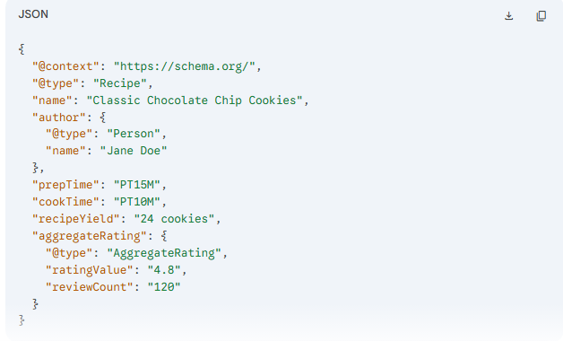

Slide 37
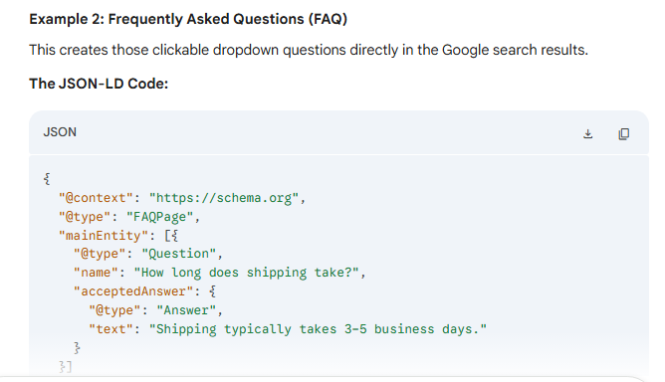

Slide 38







Schema Markup — What It Is & All Major Types
Structured data that tells Google exactly what your content means — unlocking Rich Results in SERPs
Schema Markup is code (vocabulary from Schema.org) added to your HTML that helps search engines understand your content's context. It enables Rich Results — enhanced SERP listings with stars, prices, FAQs, images, and more — dramatically improving CTR.
🌟 Rich Result Examples:
⭐⭐⭐⭐⭐ 4.8 (2,341 reviews) • $29.99 • In Stock • FAQ dropdowns • How-To steps • Sitelinks • Breadcrumbs • Event dates
Article / BlogPosting
Product
FAQ Page
How-To
Use: News, blog posts, editorial content
Use: E-commerce product pages
Use: Pages with question & answer format
Use: Step-by-step guides and tutorials
✦ Article rich card, Google News eligibility, enhanced authorship display
✦ Price + rating stars + availability shown directly in Google Search results
✦ Expandable Q&A dropdowns in SERPs — doubles listing height, huge CTR boost
✦ Step-by-step preview shown in SERPs, rich snippet with images per step
Local Business
Review / Rating
Event
Person
Use: Physical businesses (restaurants, shops, clinics)
Use: Review/rating pages for products, books, movies
Use: Concerts, webinars, workshops, conferences
Use: About pages, author bios, professional profiles
✦ Google Business Panel, map integration, opening hours directly in search
✦ Star ratings displayed in SERPs — up to 30% CTR increase in studies
✦ Event dates and ticket links shown in Google Search and Maps
✦ Knowledge Panel for notable people, authorship attribution for E-E-A-T
BreadcrumbList
Video Object
Recipe
Organization / Website
Use: Site navigation hierarchy on every page
Use: Pages with embedded video content
Use: Food/cooking websites with recipe content
Use: Company homepage / root website
✦ Breadcrumb path shown below URL in SERPs: Home > Category > Page
✦ Video thumbnail + duration shown in SERPs, eligible for Video Carousel
✦ Recipe card with image, cook time, ratings in Google Search rich results
✦ Company Knowledge Panel, logo in SERPs, sitelinks search box eligibility
🔧 Validate all schema: search.google.com/test/rich-results | Full vocabulary: Schema.org | Generate: technicalseo.com/tools/schema-markup-generator

Slide 39

Black Hat SEO
Techniques that violate Google's guidelines — can cause permanent penalties or deindexing
⚠️ WARNING: These techniques may work short-term but result in Google Manual Actions (penalties), algorithmic deindexing, and permanent loss of all organic traffic. NEVER use these techniques.
Keyword Stuffing
PENALIZED
Cloaking
DEINDEXED
Private Blog Networks (PBN)
DEINDEXED
Unnaturally cramming keywords into content, meta tags, or hidden text. Example: 'Buy shoes. Cheap shoes. Best shoes online. Shoes for sale cheap shoes.'
Showing different content to Googlebot vs. actual users. Crawler sees keyword-rich text; users see something different (e.g., casino pages behind a news site).
Building a network of fake 'authority' websites solely to link back to your money site. Very expensive and high risk.
⚠ Panda algorithm targets thin/stuffed content. Manual action possible.
⚠ Immediate deindexing if detected. Violates Google's core policies.
⚠ Penguin/Link algorithm detects unnatural patterns. Full network deindexed.
Spammy Link Schemes
PENALIZED
Content Scraping & Spinning
DEINDEXED
Hidden Text & Links
PENALIZED
Buying links, link farms, automated link building software, hidden links, excessive reciprocal linking. Thousands of overnight links raise red flags.
Copy-pasting content or using AI/software to 'spin' articles (replace words with synonyms). Creates duplicate/thin content with no value.
Making text same color as background, setting font-size to 0px, or hiding links in images/CSS to inject keywords without user visibility.
⚠ Google Penguin targets manipulative link patterns. Manual link penalties.
⚠ Panda devalues thin content. Duplicate content filters reduce rankings to zero.
⚠ Easily detected by Google's algorithms. Immediate ranking penalty applied.

Slide 40

Grey Hat SEO
Tactics in the gray zone — not explicitly banned but risky, depending on scale and context
Grey Hat = tactics that exist in a gray area. Google doesn't explicitly penalize them, but may in the future. Risk depends on scale, frequency, and how obviously manipulative they are.
Buying Expired Domains
RISK: MEDIUM
Aggressive Guest Posting at Scale
RISK: MEDIUM
Purchase expired domains with existing authority and backlinks, then 301-redirect to your site. Technically allowed but risky if done obviously.
Guest posting for links (not traffic/brand) violates Google's guidelines — but is widely practiced. Risk increases with low-quality posts on irrelevant sites.
⚡ Grey because: Scale and intent determines risk. 1–2 = fine. A network = Black Hat PBN.
⚡ Grey because: Quality guest posts on relevant sites = White Hat. Spammy posts = Black Hat.
Paid Reviews / Sponsored Posts
RISK: MEDIUM-HIGH
CTR Manipulation
RISK: HIGH
Paying for reviews with dofollow links without disclosure. FTC also requires disclosure. Google considers it link manipulation if not marked 'sponsored' or 'nofollow'.
Using bots, click farms, or incentivizing users to click your result to artificially inflate CTR. Hard to detect but risky if patterns look unnatural.
⚡ Fix: Use rel='sponsored' or rel='nofollow' on paid links — makes it White Hat.
⚡ Grey because: Not 100% confirmed as ranking factor but widely believed to impact rankings.
Social Signals Manipulation
RISK: LOW-MEDIUM
Reciprocal Linking (Excessive)
RISK: MEDIUM
Buying social shares, likes, or followers to appear more popular. Direct impact on Google rankings is debated.
Exchanging links with other sites ('I link to you, you link to me'). A few contextual reciprocal links are natural. A large coordinated exchange scheme is penalized.
⚡ Grey because: Social signals are a weak indirect factor. Scale = more risk.
⚡ Grey because: Natural occasional exchanges are fine. Organized schemes are penalized.
⚪ WHITE HAT: Sustainable, ethical, long-term ⬛ BLACK HAT: Risky, short-term, penalties ◑ GREY HAT: Depends on scale & execution — approach with caution

Slide 41
How Google Ranks Websites
Crawling → Indexing → Processing → Ranking
Crawling
Indexing
Processing
Ranking
Serving
1. CRAWLING
2. INDEXING
3. RANKING
What it is:
What it is:
What it is:
Googlebot (Google's web crawler) automatically discovers and visits web pages by following links from page to page across the internet.
After crawling, Google analyzes page content (text, images, videos) and stores it in its massive database called the Google Index — like a library catalogue.
When a user searches, Google retrieves relevant pages from the index and orders them using 200+ ranking signals to show the most helpful results.
How it works:
How it works:
Core Ranking Signals:
Starts from known URLs → follows every hyperlink → revisits pages periodically. Crawl frequency depends on PageRank, update frequency, and server load.
Google parses HTML → extracts keywords, entities, and structured data → evaluates quality signals → decides whether to index the page.
Relevance (keyword match) • Content quality (E-E-A-T) • Backlink authority (PageRank) • User experience (Core Web Vitals) • Context (location, device)
💡 Use robots.txt to control crawls. Submit XML sitemaps to help Google discover new pages faster.
💡 Use Google Search Console → URL Inspection to check if a page is indexed. Unindexed pages never appear in search results.
💡 Google's algorithms (Panda, Penguin, BERT, MUM, RankBrain) continuously refine results using AI and machine learning.

Slide 42
E-E-A-T: Google's Quality Framework
Experience · Expertise · Authoritativeness · Trustworthiness
E-E-A-T is from Google's Search Quality Rater Guidelines — used by human quality raters AND Google's algorithms. Critical for YMYL topics: health, finance, legal, safety.
E
EXPERIENCE
E
EXPERTISE
A
AUTHORITATIVENESS
T
TRUSTWORTHINESS
Google's Quality Signal
Google's Quality Signal
Google's Quality Signal
Google's Quality Signal
First-hand, real-world experience with the topic. Has the author actually used the product or lived through the situation?
Formal or demonstrated knowledge in the field. Does the content show deep understanding?
Recognition by others as a go-to source. Is the website/author cited and trusted by other authoritative sources?
The most important E-E-A-T factor. Is the site honest, transparent, and safe?
Ranking Signals:
Ranking Signals:
Ranking Signals:
Ranking Signals:
› Personal stories & case studies
› Author credentials (degrees, certifications)
› High-quality backlinks from authority sites
› HTTPS security certificate
› Photos/videos from real use
› In-depth, accurate information
› Brand mentions in major publications
› Clear About Us & author pages
› Specific details only an expert would know
› Citing authoritative sources
› Wikipedia citations
› Transparent privacy policy & T&Cs
› Author bio showing lived experience
› Correct technical terminology
› Industry awards & recognition
› Accurate, fact-checked content
✓ A travel blogger who visited Hunza Valley writes about trail difficulty and local food they personally tried.
✓ A cardiologist writing about heart disease treatment, citing clinical studies.
✓ WebMD referenced by hospitals, NHS, and medical journals.
✓ An e-commerce site with SSL, clear return policy, real customer reviews.
✗ AI-generated travel guide listing 'Top 10 Places' with no personal insight.
✗ A general blogger writing about medication dosage without medical qualifications.
✗ Unknown health blog with no external links or recognition.
✗ Site with no author info, hidden ownership, and conflicting health claims.

Slide 43

Google Ads (SEM Platform)
Google Ads is an online advertising platform where businesses bid on keywords to display ads in Google Search results. Pay-Per-Click (PPC) model.
The Ad Auction Process:
1
2
3
4
5
User Searches
Auction Triggered
Ad Rank Calculated
Ads Displayed
User Clicks
Ad Rank Formula
Campaign Structure
Ad Rank = Bid × Quality Score × Expected Impact
Campaign: Budget, bidding strategy, campaign type
• Max Bid: Maximum you're willing to pay per click • Quality Score (1-10): CTR, ad relevance, landing page • Higher Ad Rank = Better position & lower actual CPC
Ad Group: Thematically grouped keywords
Keywords: Exact/phrase/broad match terms
Ads: Headlines, descriptions, URLs

Slide 44
Google AdSense
Google AdSense is a FREE program allowing website owners to earn money by displaying Google Ads. Publishers earn revenue when visitors click or view ads.
Google Ads vs Google AdSense:
Google Ads (Advertiser)
Google AdSense (Publisher)
• You PAY Google to show your ads • Target: customers searching your keywords • Goal: Drive traffic, leads, and sales • You are the ADVERTISER
• Google PAYS YOU to show ads • Your site displays ads to visitors • Goal: Monetize website traffic • You are the PUBLISHER
How to Monetize with AdSense:
1. Apply for AdSense
2. Paste Ad Code
3. Ads Display
4. Earn Revenue
Site needs quality content, privacy policy, custom domain
Add Google's JavaScript snippet to your website
Google shows relevant ads to visitors automatically
Get paid per click (CPC) and per 1000 views (CPM)

Slide 45
Essential SEO Tools & KPIs to Track
Must-Have SEO Tools:
Key Performance Indicators (KPIs):
Google Search Console
Organic Traffic:
Monthly visits from unpaid search results
FREE
Monitor search performance, fix crawl errors, submit sitemaps, track rankings
Keyword Rankings:
Position of target keywords in SERPs
FREE
Google Analytics 4
Click-Through Rate (CTR):
Clicks ÷ Impressions from search
Track website traffic, user behavior, conversions, and ROI
Google Keyword Planner
Bounce Rate:
% visitors leaving without interacting
FREE
Find keyword ideas, search volumes, and CPC data
Domain Authority (DA):
Moz's 1–100 score for ranking potential
PAID
Ahrefs
Backlinks Count:
Number of quality external links
Backlink analysis, keyword research, competitor research, rank tracking
SEMrush
Page Load Speed:
Core Web Vitals scores (LCP, CLS, INP)
PAID
All-in-one: keywords, audits, backlinks, competitor analysis
Conversion Rate:
% of visitors completing desired action
FREE/PAID
Yoast SEO / RankMath
Impressions (GSC):
How often site appears in search results
WordPress plugin for on-page optimization, sitemaps, schema

Slide 46
Key Takeaways & Best Practices
SEO is a long-term investment — consistently create high-quality, user-focused content
Focus on SEARCH INTENT — match your content type to what the user is looking for
🎯
🔑
Schema Markup is essential — add JSON-LD for FAQ, Product, Article, HowTo to unlock rich results and boost CTR
Build quality backlinks — use skyscraper, HARO, original research, and resource pages for white-hat links
🏷️
🔗
Technical foundations matter — fast, mobile-friendly, secure sites are prerequisites for ranking
Measure everything — use Google Analytics + Search Console to track performance
⚡
📊
NEVER use Black Hat SEO — short-term gains lead to permanent penalties and loss of all traffic
E-E-A-T is non-negotiable — demonstrate Experience, Expertise, Authority, and Trust in every piece of content
⚪
🏆
Remember: SEO + SEM is a continuous process. White Hat always wins in the long run.

